Slide 1
DC# Converter
Created by Dylan Barnes, Ryan Kilbride, and Cameron Kerbaugh
Part of DC# (Data Control Sharp) Software Suite

Slide 2

A Broad Overview of DC# Converter
Designed to convert between data files, such as XML, JSON, and CSV.
Easy to use through a GUI, Command-Line, or C# Library.
Intuitive functionality through all types of interfaces.
Parsing options for each file type.
Data view via a data grid generated after parsing.

Slide 3
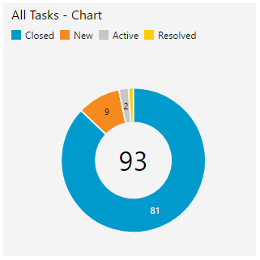
Agile Methodology
The Agile methodology was used throughout the development of DC# Converter.
Agile involves iteratively implementing features and creating documentation after the fact.
Used Team Foundation Server to manage sprints.

Slide 4
Features
Core Features
Additional Features
Specify input/output file types.
Portability via GUI, Command-Line, and Library.
Data View is generated during parsing to display file contents.
Output File Options.
Select remote files via a URL to be converted.
Interface with other members of the DC# Software Suite

Slide 5
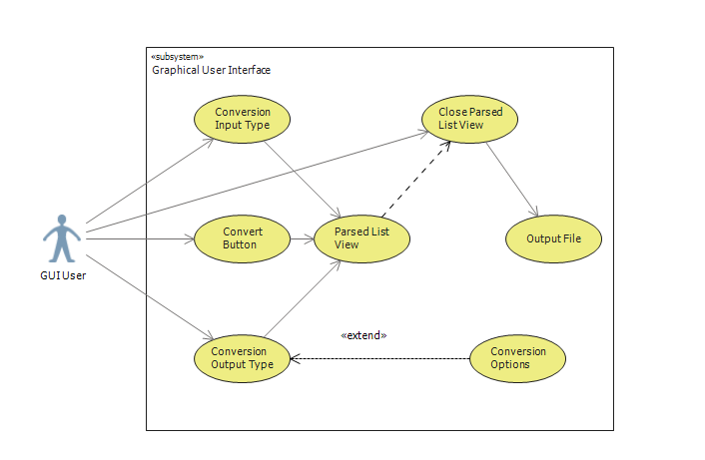
UML Use Case Diagrams
Diagram 1 – Graphical User Interface

Slide 6
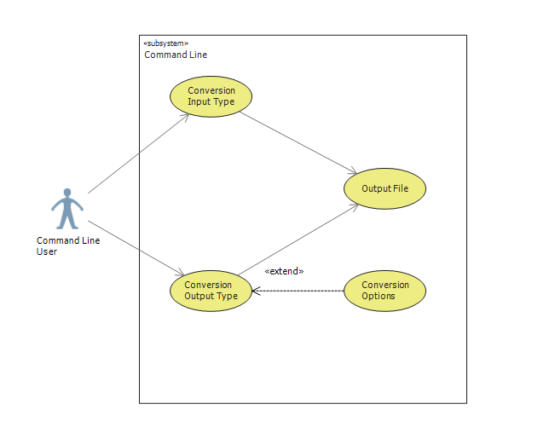
UML Use Case Diagrams
Diagram 2 – Command Line Interface

Slide 7
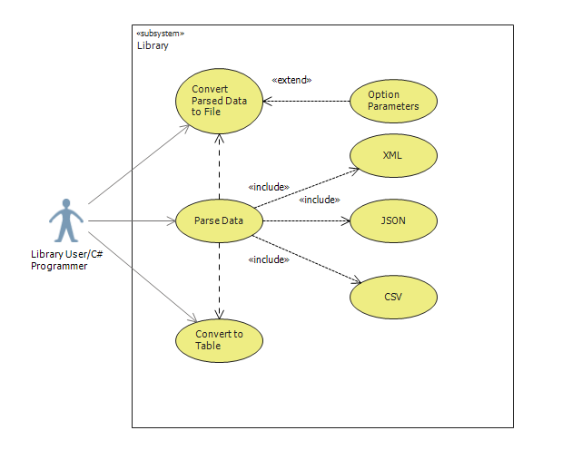
UML Use Case Diagrams
Diagram 3 – C# Library

Slide 8
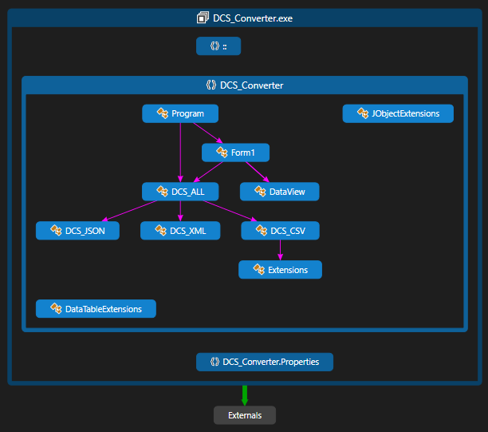
Code Diagrams
Broad Class Overview

Slide 9
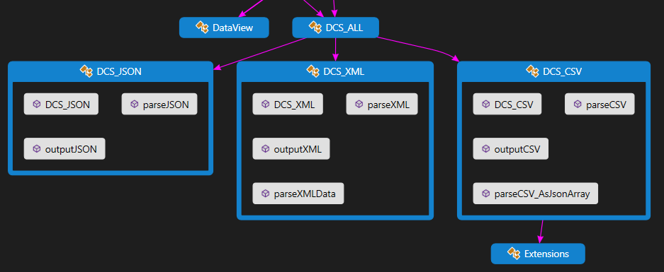
Code Diagrams
Specific Classes Example – DCS_JSON, DCS_XML, and DCS_CSV

Slide 10
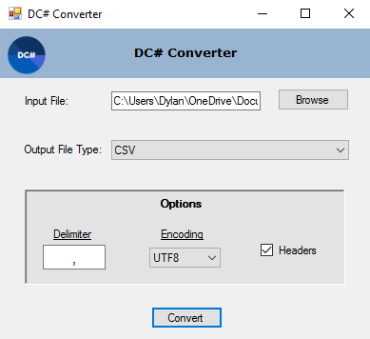
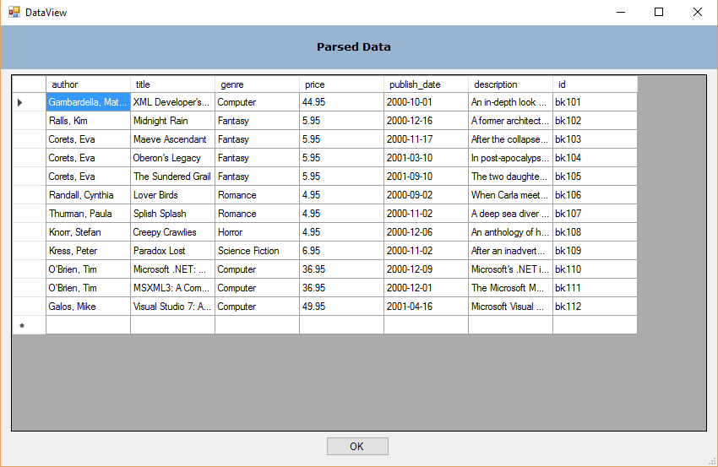
Graphical User Interface
Main Interface – Form1()

Slide 11
Design Tools and Resources
Visual Studio 2015
C# and .NET Framework
Team Foundation Server
JSON.NET
CommandLine Parser

Slide 12

Future Plans
Release as an open source project on Github.
Incorporate in a large software suite known as DC#.
Continue development after graduation.
Encourage others to partake in development.

Slide 13


